Slide 1


Heart Disease Prediction System using Machine Learning (CAD and Arrhythmia)
Prepared by Group 13–
Abhishek Paul 11500121027
Bishal Prasad 11500121045
Naincy Kumari 11500121052
Md Zunaid Ahmed 11500121080
Under Supervision of : Sudip Kundu

Slide 2
Table of contents
1
Introduction
2
Objectives
3
Uniqueness And Importance
4
Work done on data
5
Challenges faced
6
Workflow of the project
7
Performance comparison
8
Conclusion

Slide 3

Introduction
Coronary Artery Disease (CAD) is also known as ischemic heart disease.
It occurs when coronary arteries become narrowed or blocked due to plaque buildup (atherosclerosis).
This reduces the oxygen-rich blood supply to the heart.
Major causes include:
Poor diet
Smoking
Lack of exercise
Medical conditions like hypertension, diabetes, high cholesterol
Genetic factors
Common symptoms:
Chest pain (angina)
Shortness of breath
Fatigue
Dizziness (especially during exertion)
Complications:
Heart attacks
Heart failure
Early detection and lifestyle changes are crucial to prevent worsening and promote heart health.

Slide 4
Introduction
Arrhythmia is any deviation from the heart’s normal rhythm—too fast, too slow, or irregular. It happens when the heart’s electrical system misfires, disrupting coordinated atrial and ventricular contractions.
Major causes include: • Underlying heart disease (e.g., coronary artery disease, cardiomyopathy) • Electrolyte imbalances (low potassium or magnesium) • Medications or stimulants (some cardiac drugs, caffeine, alcohol) • Thyroid disorders (hyperthyroidism can trigger tachycardia) • Genetic predisposition
Common symptoms: • Palpitations (fluttering or “skipped” beats) • Dizziness or lightheadedness • Shortness of breath • Chest discomfort or tightness • Fatigue or weakness
Complications: • Stroke (especially with atrial fibrillation) • Heart failure (from sustained rapid or slow rhythms) • Syncope (fainting due to a slow rhythm or pause) • Cardiac arrest (in severe ventricular arrhythmias)

Slide 5


Objective of the System
Project Objective: Build ML models for CAD risk (yes/no) and arrhythmia classification (15 classes) in one Streamlit app.
1. Data Collection & Preprocessing: Gather and clean 14 clinical features for CAD and 25 ECG features for arrhythmia, encoding and normalizing as needed.
2. Model Development: Train a binary classifier for CAD and a multiclass classifier for arrhythmia, addressing class imbalance.
3. Model Evaluation: Validate CAD with accuracy/ROC‐AUC and arrhythmia with per‐class precision/recall and F1.
4. Deployment: Use Streamlit to collect inputs and display CAD risk plus arrhythmia probabilities in real time.

Slide 6
Uniqueness of our Project
Importance of our project
The system has the potential to revolutionize healthcare by enabling early disease detection, personalized care, and improved health outcomes for individuals and society.
Early Detection & Prevention: Flags both CAD and arrhythmia before symptoms worsen, enabling timely intervention.
Improved Diagnostic Accuracy: Uses data-driven models to outperform traditional methods, reducing misdiagnosis.
Personalized Treatment: Tailors care plans based on individual risk for both CAD and arrhythmia, boosting outcomes.
Cost Savings: Prevents expensive procedures and hospital stays through proactive screening.
Research Insights & Efficiency: Provides clinicians with rapid, streamlined assessments and contributes to advancing cardiovascular research.
Improved Health Outcomes: Early diagnosis allows for timely intervention and better treatment outcomes.
Enhanced Patient Engagement: Empowers individuals to take proactive steps towards maintaining their health.
Global Health Impact: This technology can be deployed globally to address diverse healthcare needs.
Reduced Healthcare Costs: Preventative measures and targeted treatment reduce the burden on healthcare systems.

Slide 7
Key features of Dataset
CAD Dataset: – Contains 14 clinical and demographic features (age, sex, chest pain type, resting blood pressure, cholesterol, fasting blood sugar, resting ECG, max heart rate, exercise angina, ST depression, slope, number of vessels, thalassemia). – Target is binary (1 = presence of CAD, 0 = absence). – Used to train ML models to identify patterns (e.g., high BP or cholesterol) that predict coronary artery disease risk.
Arrhythmia Dataset: – Contains 25 ECG‐derived features (age, sex, height, weight, heart rate, QRS duration, P-R/Q-T/T intervals, Q/R/S/R'/S' wave amplitudes, Amp_R_Wave, JJ_Wave, Int_Def, QRSA, QRSTA, plus DII/DIII/AVR/AVL/AVF/V1 mean and max values). – Target is multiclass (15 arrhythmia types, from Normal through A-fib/flutter, LV hypertrophy, AV blocks, bundle branch blocks, etc.). – Used to train ML models to estimate probability across 15 rhythm categories, enabling early detection and tailored intervention.

Slide 8
Key features of Dataset
The dataset for Coronary Artery diseases contains 303 entries with the following 14 features, all of which are non-null:
age: Age of the patient (integer)
sex: Sex (1 = male; 0 = female)
cp: Chest pain type (0–3, indicating different severity levels)
trestbps: Resting blood pressure (mm Hg)
chol: Serum cholesterol (mg/dl)
fbs: Fasting blood sugar > 120 mg/dl (1 = true; 0 = false)
restecg: Resting electrocardiographic results (0–2)
thalach: Maximum heart rate achieved
exang: Exercise-induced angina (1 = yes; 0 = no)
oldpeak: ST depression induced by exercise relative to rest
slope: The slope of the peak exercise ST segment (0–2)
ca: Number of major vessels (0–4) colored by fluoroscopy
thal: Thalassemia (0 = normal; 1 = fixed defect; 2 = reversible defect)
target: Target variable (1 = presence of heart disease; 0 = absence)

Slide 9
Key features of Dataset
R'-Wave: R′-wave amplitude (mV)
S'-Wave: S′-wave amplitude (mV)
Amp_R_Wave: R-wave amplitude peak (mV)
JJ_Wave: J-junction wave amplitude (mV)
Int_Def: Intrinsic deflection flag (0/1)
QRSA: QRS axis flag (0/1)
QRSTA: QRS-T angle (degrees)
DII_mean: Mean amplitude in lead DII (mV)
DIII_mean: Mean amplitude in lead DIII (mV)
AVR_mean: Mean amplitude in lead aVR (mV)
AVL_mean: Mean amplitude in lead aVL (mV)
AVF_mean: Mean amplitude in lead aVF (mV)
V1_mean: Mean amplitude in lead V1 (mV)
Arrhythmia Dataset:
– Contains 452 entries with 25 features, all non-null:
Age: Age of the patient (years)
Sex: Sex (1 = male; 0 = female)
Height: Height (cm)
Weight: Weight (kg)
Heart_Rate: Heart rate (beats per minute)
QRS_Dur: QRS duration (ms)
P-R_Int: P-R interval (ms)
Q-T_Int: Q-T interval (ms)
T_Int: T interval (ms)
Q_Wave: Q-wave amplitude (mV)
R_Wave: R-wave amplitude (mV)
S_Wave: S-wave amplitude (mV)
Target is multiclass (15 arrhythmia categories), used to train models that estimate the probability of each rhythm type.

Slide 10
Feature Selection and Engineering
1
2
3
Feature Identification
Feature Engineering
Feature Selection
Key features for prediction include age, gender, family history, blood pressure, cholesterol, smoking status, ECG readings, heart rate, and arrhythmia indicators.
Creating new features from existing ones to enhance model performance. For example, combining multiple features into a single composite feature.
Selecting the most informative features to improve model accuracy and reduce complexity. This involves using methods such as feature importance, correlation analysis, and dimensionality reduction.

Slide 11
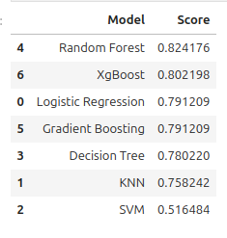
Model performance analysis (CAD)
Random Forest (Score: 0.824) – Top performer due to:
Ability to handle non-linear relationships.
Robustness to noise and overfitting.
Effective feature importance ranking.
XGBoost (Score: 0.802) – Excels with complex data but requires careful tuning.
Gradient Boosting (Score: 0.791) – Similar to XGBoost but slower.
Logistic Regression (Score: 0.791) – Simple and interpretable but struggles with non-linear interactions.
Decision Tree (Score: 0.780) – Prone to overfitting; lacks robustness of ensemble methods. KNN (Score: 0.758) – Struggles with high-dimensional and imbalanced datasets.
SVM (Score: 0.516) – Sensitive to hyperparameters and scaling; unsuitable for this application.

Slide 12
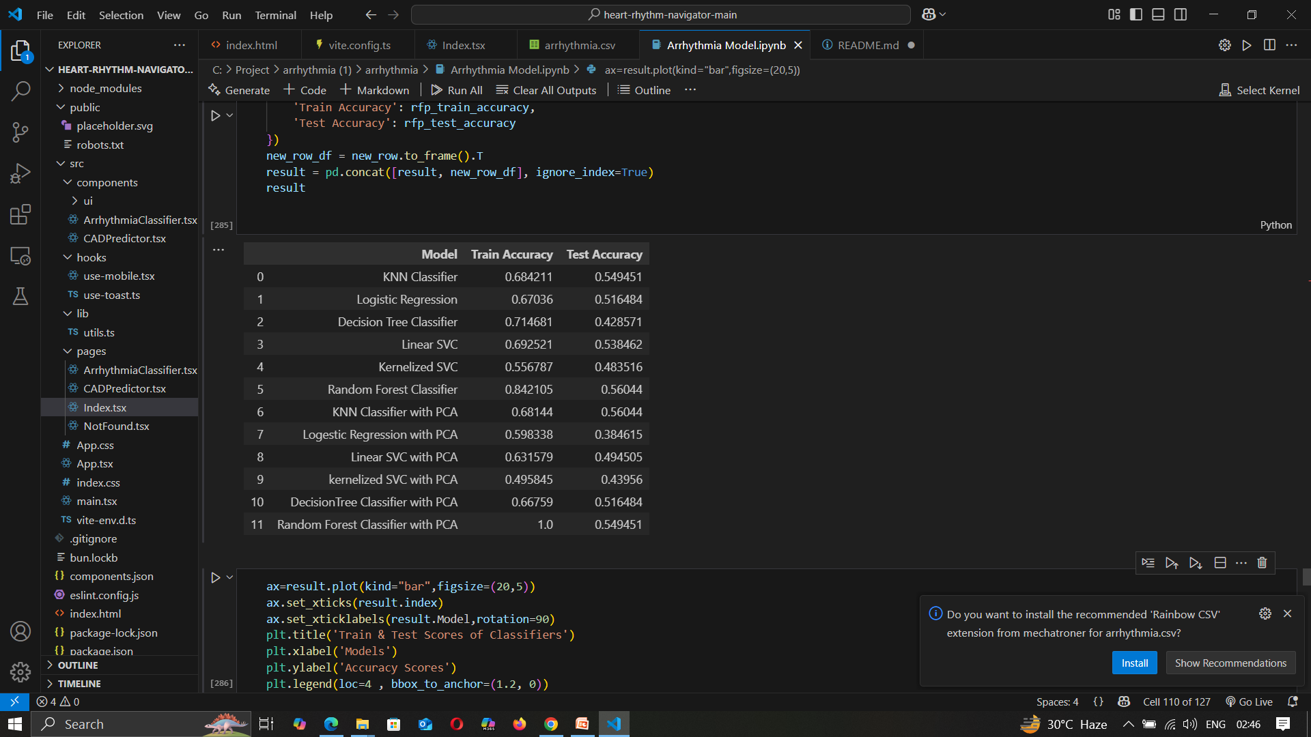
Model performance analysis (Arrhythmia)
Random Forest Classifier (Score: 0.842) – Best performer due to robustness to overfitting, handling non-linear patterns, and feature importance ranking.
Decision Tree Classifier (Score: 0.714) – Good for understanding data but prone to overfitting.
Linear SVC (Score: 0.692) – Performs moderately but limited for non-linear patterns.
KNN Classifier (Score: 0.684) – Sensitive to data distribution; struggles in high dimensions.
Logistic Regression (Score: 0.670) – Simple, interpretable model but limited for complex data.
KNN Classifier with PCA (Score: 0.681) – Slightly lower score; PCA may reduce key information.
Linear SVC with PCA (Score: 0.631) – PCA reduces variance; slightly weaker performance.
Logistic Regression with PCA (Score: 0.598) – Lower accuracy post-dimensionality reduction.
Kernelized SVC (Score: 0.556) – Struggles due to data complexity; sensitive to tuning.
Kernelized SVC with PCA (Score: 0.495) – Lowest score; PCA reduces kernel SVC’s ability to model non-linear patterns.

Slide 13
Model performance analysis
Model Insights: CAD and Arrhythmia Prediction Ensemble Models Dominate: Random Forest outperforms all others, showing the power of ensemble learning for both CAD and Arrhythmia detection.
Simplicity vs. Complexity: Logistic Regression is interpretable but struggles with complex patterns, while Decision Trees offer moderate performance.
Random Forest Stands Out: Combines high accuracy, robustness, and interpretability, making it the top choice for both datasets.
PCA Trade-off: PCA reduces dimensionality but may hurt model performance by losing key features, especially for models like SVC.
Conclusion: Random Forest is the most reliable model for predicting both CAD and Arrhythmia.
Future Work:
Fine-tune ensemble models.
Expand datasets for stronger generalization and accuracy.

Slide 14
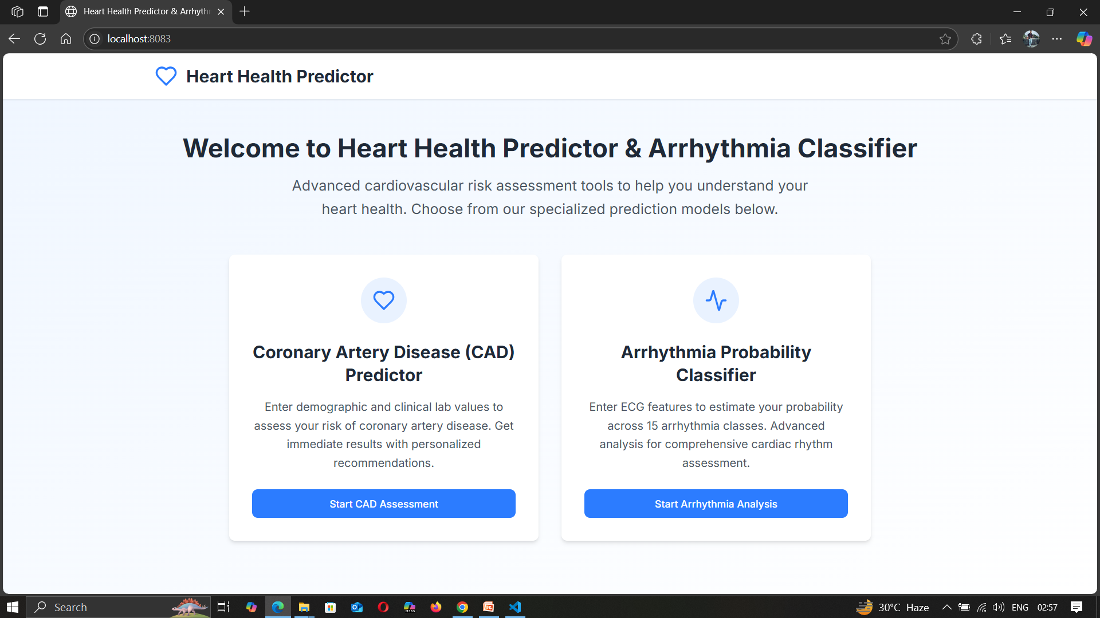
Our Website interface

Slide 15
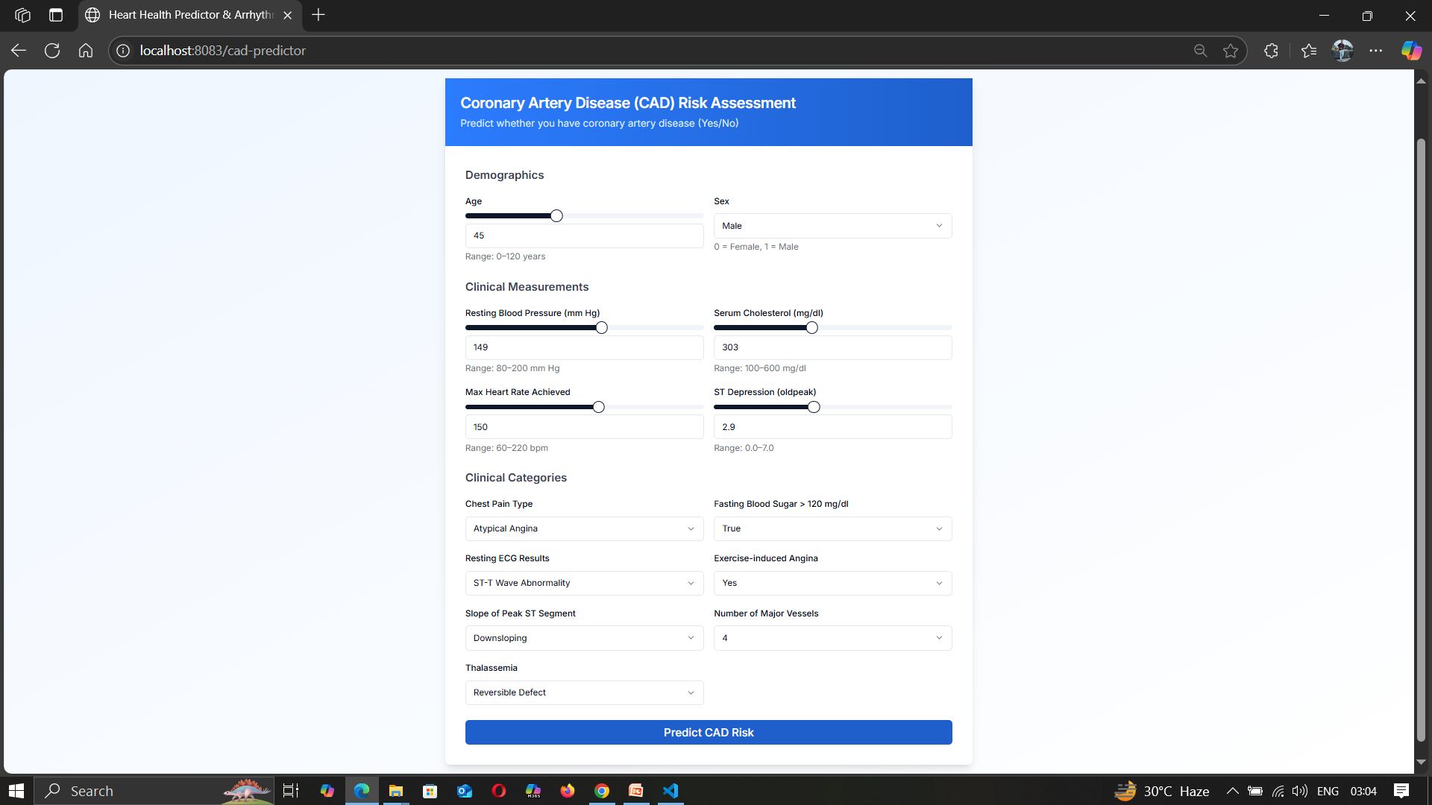
Our Website interface

Slide 16
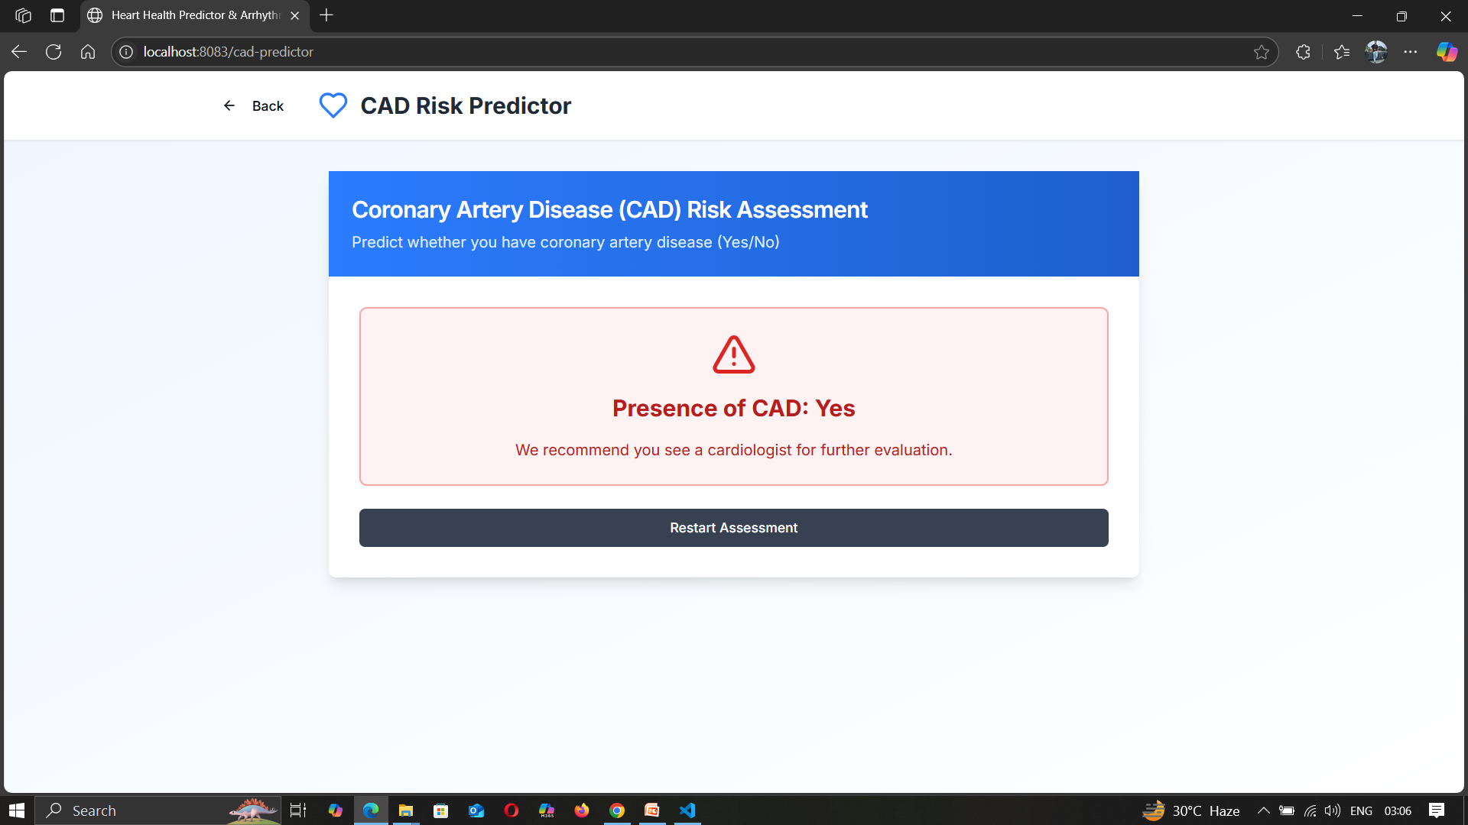
Our Website interface

Slide 17
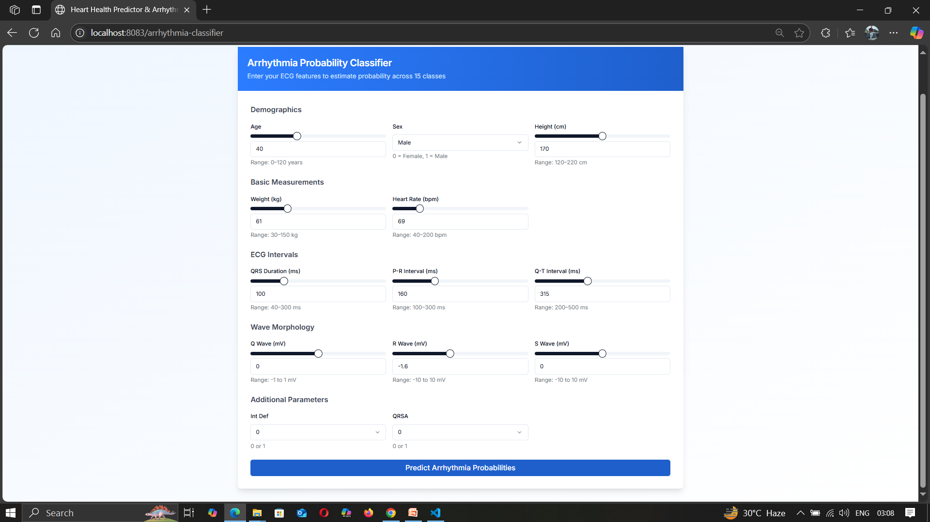
Our Website interface

Slide 18
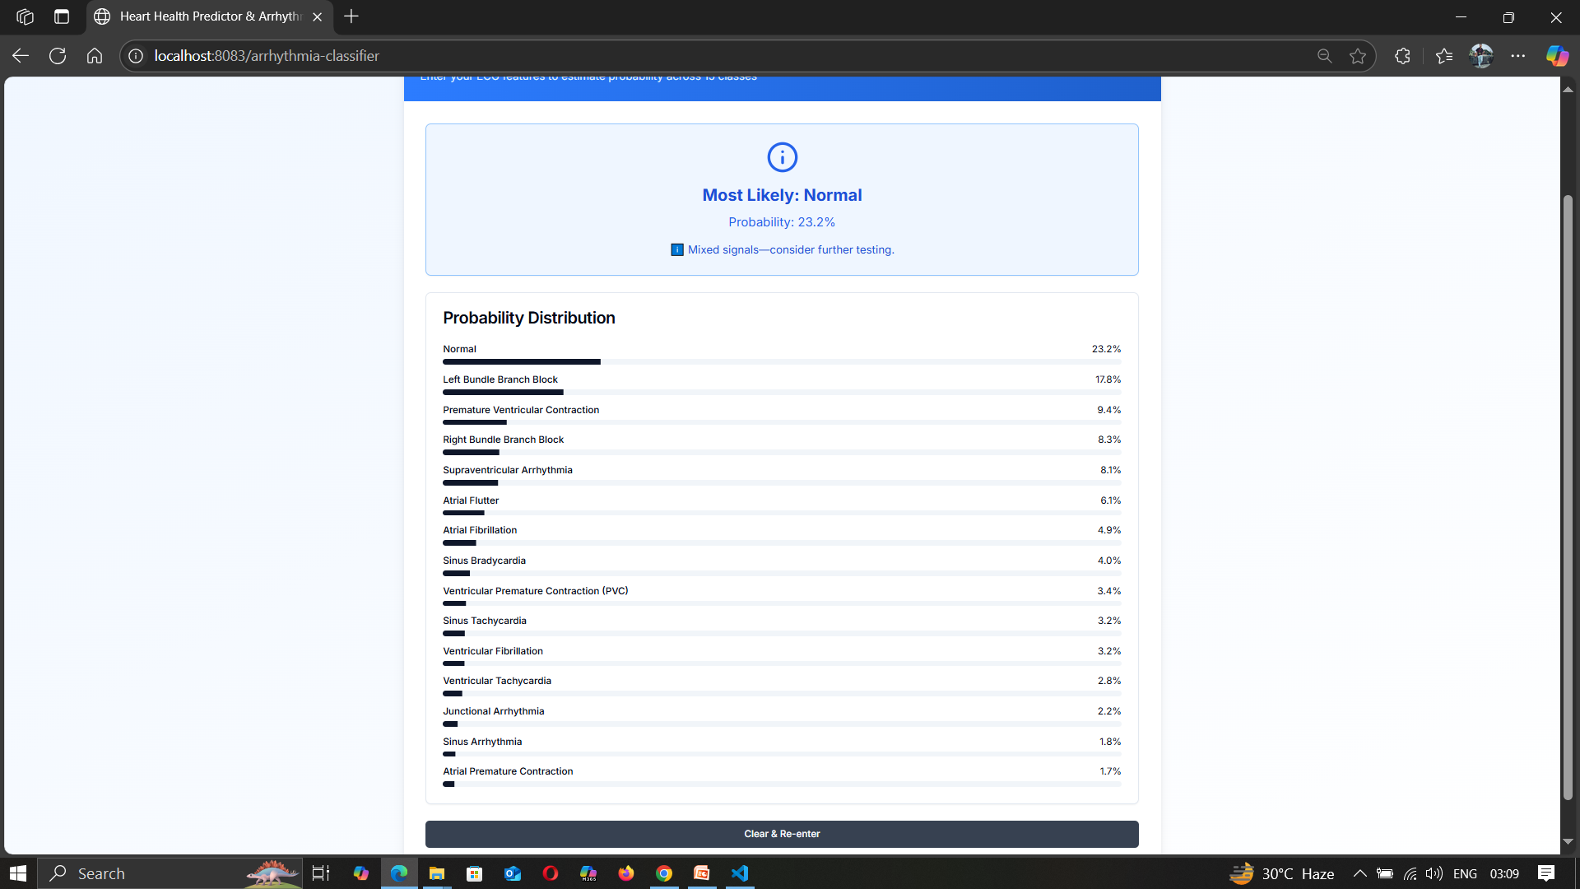
Our Website interface

Slide 19
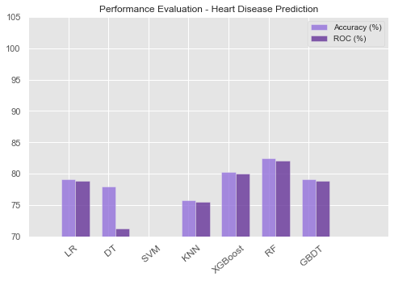
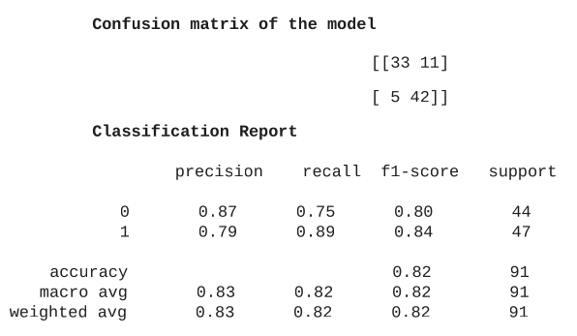
Result (CAD)
Random Forest

Slide 20
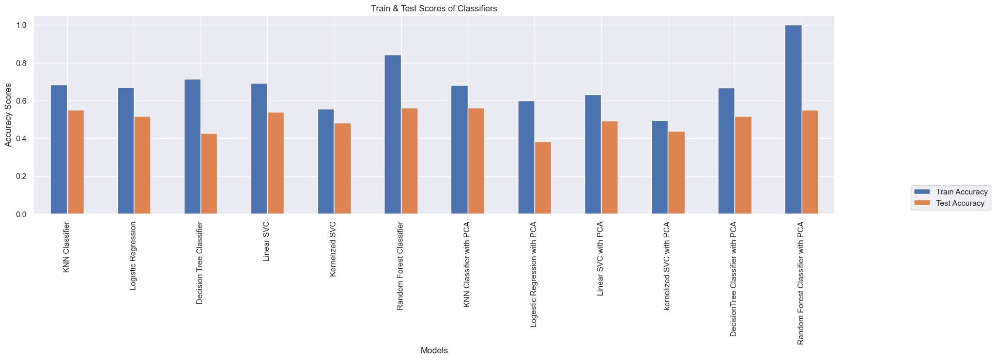
Result (Arrhythmia)

Slide 21
Future plans
Dataset Expansion
Collect and incorporate larger and more diverse datasets from multiple sources to improve model
generalization.
Model Optimization & Enhancement
Reduce false positives and false negatives by refining feature engineering techniques.
Real-Time Deployment & API Integration
Develop an API to integrate the prediction model into existing electronic health record (EHR) systems for
seamless use in hospitals and clinics.
Optimize the model for real-time processing to provide instant results to medical practitioners.
Cloud & Mobile Integration
Deploy the system on cloud platforms like AWS, Google Cloud, or Azure for remote accessibility.
Develop a mobile-friendly version to allow patients and healthcare providers to access predictions from
anywhere.

Slide 22

Conclusion
The Heart Disease Prediction System (for CAD and Arrhythmia) demonstrates the power of AI in non-invasive, cost-effective, and efficient early detection of cardiovascular diseases.
Machine Learning models improve diagnostic accuracy and enable timely interventions, reducing the risk of heart attacks, arrhythmias, and sudden cardiac death.
Advanced techniques like feature engineering, hyperparameter tuning, and cross-validation enhance model performance.
Evaluation metrics like accuracy, precision, recall, and AUC-ROC ensure model reliability.
The system offers a user-friendly web-based interface for clinicians to input patient data and receive real-time risk predictions.
Intuitive visualizations and interpretability support better clinical decision-making.
This approach reduces hospitalizations, healthcare costs, and promotes personalized treatment strategies.
Encourages AI adoption in clinical settings for cardiovascular care.
Future improvements include:
Expanding the dataset for better generalization.
Integrating Explainable AI (XAI) for transparency.
Deploying cloud-based solutions for broader accessibility.
Overall, this system marks a significant step toward AI-powered, personalized healthcare for the early detection and management of both CAD and Arrhythmia.

Slide 23
References
1. Saeedbakhsh, S., Sattari, M., Mohammadi, M., Najafian, J., & Mohammadi, F. (2023). Diagnosis of
coronary artery disease based on machine learning algorithms support vector machine, artificial neural
network, and random forest. Advanced Biomedical Research, 12(1).
https://doi.org/10.4103/abr.abr_383_21
2. Vishnuvardhan, T., & Rama, A. (2023). Comparison of Accuracy Rate in Prediction of Cardiovascular
Disease using Random Forest with Logistic Regression. Cardiometry, 25, 1526–1531.
https://doi.org/10.18137/cardiometry.2022.25.15261531
3. Karthi, C., & Kalaivani, A. (2023). Heart Disease Prediction Based on Age Detection Using Logistic
Regression over Random Forest. Cardiometry, 25, 1731–1737.
https://doi.org/10.18137/cardiometry.2022.25.17311737
4. Yan, C., Xing, Y., Liu, S., Gao, E., & Wang, J. (2024). Machine Learning Models for Cardiovascular
Disease Prediction: A Comparative study. bioRxiv (Cold Spring Harbor Laboratory).
https://doi.org/10.1101/2024.05.27.596092

Slide 24
Thank You!

